Slide 1
Elected officials forum
January 5, 2017
Catawba Regional Council of Governments
Gateway Center – Chester County

Slide 2
Trends in revenues and appropriations
The Great Recession had profound implication for all state governments. The ripple effects are still felt today.

Slide 4
Where is the General Fund Money Spent? Pre and Post Great Recession
 | FY 2007-08 | FY 2016-17 | Difference
K-12 Education | 2,416,284,557 | 2,954,023,087 | 537,738,530
Health and Social | 1,684,915,369 | 2,036,821,095 | 351,905,726
All Other | 1,129,360,663 | 1,230,817,960 | 101,457,297
Higher Education | 918,880,772 | 619,725,916 | -299,154,856
Correctional and Public Safety | 593,358,615 | 686,014,965 | 92,656,350
Transportation (DOT) | 186,590 | 52,125,869 | 51,939,279
 | 6,742,986,566 | 7,579,528,892 | 836,542,326
Source: Executive Budget Office

Slide 5
FY 2017 Road Funding
Recurring | Non-Recurring
$216,360,000 DOT → SIB ACT 275 (2016): S. 1258, which sends the sales tax on cars and DMV fees and fines to the DOT for the DOT to transfer to the SIB for bonding. Sales Tax on Cars ($131,360,000): Remaining 80% of the revenues (holding 20% EIA harmless) from sales, use and casual excise taxes regarding motor vehicle purchases was transferred to the State Highway Fund (SHF) at DOT. DMV Fees and Fines ($85,000,000): DMV is to transfer all fees and fines collected for its operations—e.g. charges for the licensing, registering and titling of vehicles—to the DOT. 1st $50,0000,000 BRIDGES >$50,000,000 INTERSTATES $1.6B to interstates, $700M to bridges over 10-15 years. $400M to resurfacing from freed up funds. | $49,000,000 DOT ACT 284 (2016): Allocation to DOT for Storm Recovery (Flood) match; $11.7M is to be transferred from the FEMA state match sent to the Adjutant General. $50,000,000 DOT ACT 284 (2016): Backfill of Non-Federal Aid Highway Fund (NFAHF) as 50% sales tax on cars redirected to SHF via Act 275. $50,000,000 CTCs ACT 284 (2016): Transfer of Act 92 (2015) SIB funds to the CTCs for use on the state-owned highway system for paving, rehabilitation, resurfacing, and/or reconstruction, and bridge repair, replacement, or reconstruction (proviso 117.135).

Slide 6
Formula driven budget items
Education Finance Act and the Local Government Fund.

Slide 7
Education Finance Act of 1977
The Education Finance Act is the main funding source for education funding in SC
The ADM (average daily membership) for each student classification is multiplied by the weighting factor for the respective classification to determine the weighted pupil units (WPU) for each classification. The district’s total WPU for a for all classifications is multiplied be the base student cost (BSC) to arrive at the total cost for the foundation program.
The amount of local support the district is required to provide is determined by computing the total statewide collective local share (approximately 30 percent) of the cost of the foundation program multiplied by the district’s index of taxpaying ability. The district’s index of taxpaying ability is the district’s relative fiscal capacity compared to that of all other districts in the State, based on the full market value of all taxable property in the district.
The amount the State provides to each school district is the difference between the total cost for the district to provide the foundation program and the district’s required local support.
Current appropriation for the Education Finance Act is $1,728,148,671. This is the largest single line item in the Budget. Current estimate for WPU’s is 966,029 for FY 2017.
Source: 2016-2017 Funding Manual

Slide 9
Compound Growth Rate 1.21%
Compound Growth Rate 0.68%
** Does not include Special Schools but does include Public Charter District beginning in FY 2009

Slide 10
Additional weights in the EFA Formula from Proviso 1.3
(4) Additional weights for personalized instruction:
(A) Gifted and Talented 0.15 18,695 added (B) Academic Assistance 0.15 14,073 added (C) Limited English Proficiency 0.20 9,147 added (D) Pupils in Poverty 0.20 100,922 added (E) Dual Credit Enrollment 0.15 1,652 added
In effect, this added 144,500 Weighted Pupil Units (WPU’s) bringing the total without these additional weights from 825,400 to roughly 969,900 WPU’s in FY 2016-17 that go into the EFA formula
For reference; Student Headcount (ADM) is roughly 716,400 students

Slide 11
The Local Government Fund is calculated at 4.5% of previous year’s General Fund Revenue.
H3374 of 2016 passed the House. This bill changed the LGF calculation.

Slide 12
General Fund Revenue Growth Outlook
Will growth be sufficient to restore these items to “Pre-Great Recession” levels?

Slide 13
National Total Personal Income is $16T. So, SC’s share of the national economy is about 1.25%.

Slide 14
The 10-year trend for SC Personal Income Growth is 4.1%. The BEA estimate is 4.9%.

Slide 15
For the next several years, we should expect General Fund Revenue growth above the previous year in the $300M to $400M range.

Slide 16
Pensions

Slide 23
SCRS Trust Fund Comparison of Payroll Contributions Received and Regular Benefits Paid

Slide 24
Pensions – The solution is $$$ Options:
Employee Contribution Increase (as a % of payroll)
Employer Contribution Increase (as a % of payroll)
Direct Appropriation (recurring or non-recurring)
Reduce benefits (limitations related to Supreme Court precedent)

Slide 25
Pensions Other Considerations
Lower the Assumed Rate of Return (currently 7.5%)
Implement a modified closed amortization period
Migrate to some form of a hybrid system for non-vested employees
Structural changes to the Public Employee Benefits Authority and the Retirement Investment Commission

Slide 26
Fiscal Year 17-18 Budget outlook

Slide 27
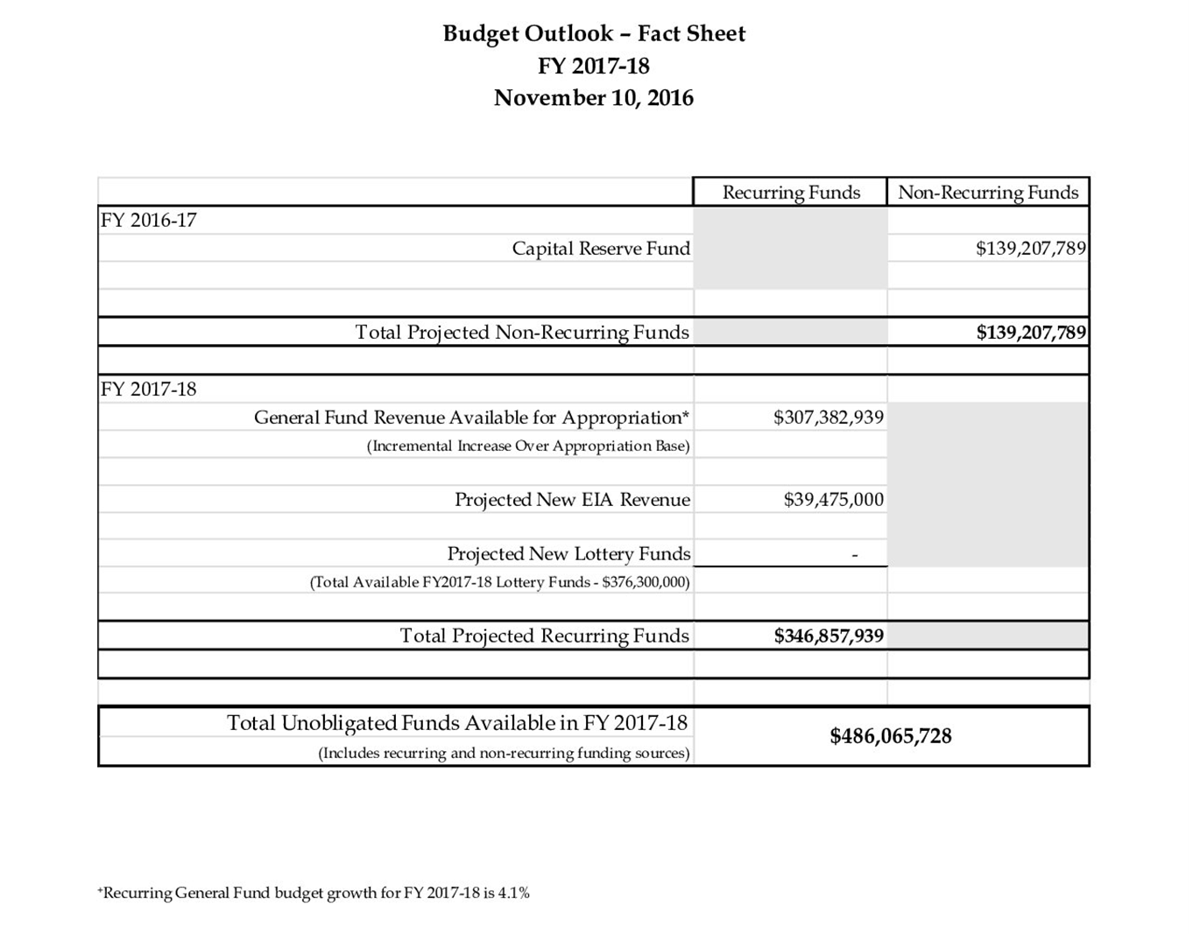
FY17-18 “New” Money

Slide 28
BASIC BUDGET OBLIGATIONS (Increases above base budget)
Education Finance Act Funding $88M (SDE increase of BSC by $150 to $2500)
Medicaid $50M (Annualization)
State Health Plan Costs $27M (Annualization and cost increases)
Reserve Fund Requirements $22M (General and Capital Reserves)
Local Government Fund $11M (Annualization)
Hurricane Matthew Costs $64M (Emergency Management Div. estimate)
School Bus Replacement $10M (SDE request recurring)
Scholarships (LIFE, Palmetto, HOPE) $21M (Growth & increased costs from grade scale to 10 points)
Pensions $??M (As much as possible)
SUBTOTAL $293M

Slide 29
Conclusion
The FY16-17 budget process could be characterized as the “Year of Plenty.” This was due to a number of one-time occurrences but primarily due to a downward bias in the revenue forecasting error. In FY17-18, the revenue forecasting error is erased.
As a result, the $307M in “new” recurring General Fund revenue above the previous year’s appropriation base is the return of the norm. So, FY17-18 will be a “back to basics” budget year.

Slide 30
Questions? My email address is: mikeshealy@scsenate.gov

